Slide 1
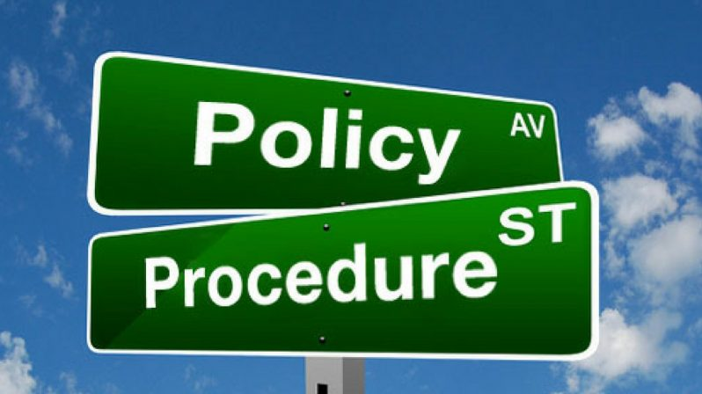

Slide 2



Local Procedure
Existing Problem
Across fleet, inconsistency in mapping local procedure. Few vessel/fleet is equipped with local procedure whereas others do not have any or very few;
Many ship-board minor operation lacks adequate risk assessment; like ER internal oil transfer for small tanks, top up of AE/ME crankcase etc.;
New joiners miss out on adopting correct and consistent steps for carrying out operation safely and correctly;
Mapping correct steps for operating machinery as per maker’s recommendation;
Control and standardize the procedure as per maker and company SMS system.
Benefit
Provide operator with knowledge about what is expected of them, e.g. behavior and performance standards;
Provide rules and guidelines for decision-making in routine situations;
Provide a consistent and clear response across all company vessels in dealing with situation
Provide a clear framework for the delegation of decision-making;
Provide a means of communicating information to new joiners
Control the ambiguity and confusion of locally developed procedure is setting up a standard
Challenges in implementation
Obtain correct procedure vessel specific/equipment specific as mentioned in maker’s manual.
Centrally Control changes and ensure fit for purpose and approved by stake holders.
The process to run consistently with change of vessel staff.
The process to be auditable subject to regular checks by office staff for its effectiveness;

